Slide 1


TezTournaments
A tournament escrow system allowing for transparent and provable payouts, created on the Tezos blockchain.

Slide 2



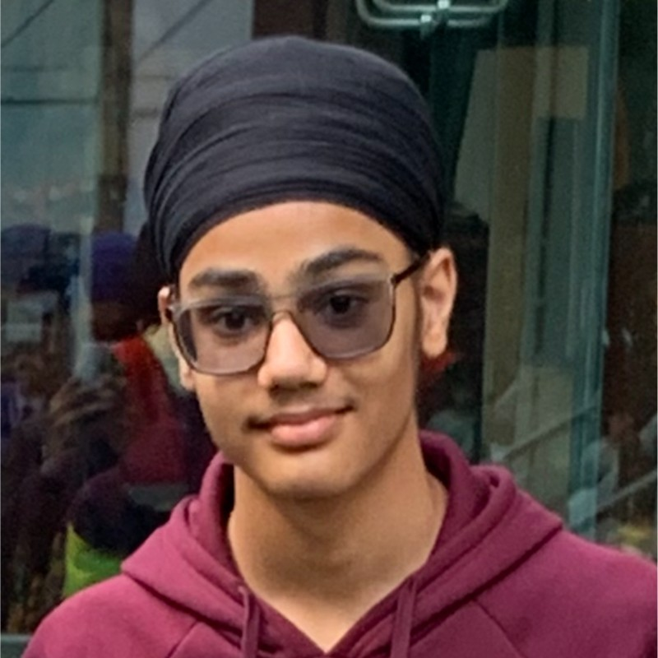
Who are we?
Adil Hashlamon
Hamzah Mohamed
Subeen Regmi
Prannvat Singh

Slide 3
What are we creating?
Tournament platform for gamers
Escrow depositing system
Proof-of-stake method to achieve consensus on the winner
Decentralized app (dApp) using the blockchain

Slide 4
Why on the Tezos Blockchain?
Fast block time so there is little to no delay
Cheap gas that allows us to run smart contract calls for less
Blockchain so all transactions can be recorded and public so everyone can see
The system will be run on smart contracts that can't be changed
Decentralized so people can only be identified using a wallet or a domain name

Slide 5
Tournaments in your hands
All aspects of tournament creation is in your hands
Price to enter, total winnings, winning structure, fee for provider
Tournament structure, the number of players, time to start, random matchmaking or qualifying round
The number in each team, total teams, free for all, NFT minting for winners.

Slide 6
Using smart contracts smartly
Our vision is a system where trust in the institution isn’t required but trust in only the code
Smart contracts include :
Escrow Depositing System
Allowing users to deposit crypto (stable coins, tez) into the platform
Allowing users to withdraw crypto that they are only allowed
Receipt creation to show how much is owed to the user in a provable system
Tournament Creation and Payment System
Allowing users to join a tournament using their crypto as collateral to buy tickets
Allowing users to create their own tournament with their own settings
System to matchmake users with each other.
Validation
Allowing players to vote who won in a specific match
Allowing validators to have cases and check if voting was done accurately
Using the depositing system as collateral if bad actors are present

Slide 7

How our system works

Slide 8

Escrow Depositing System

Slide 9
How does the escrow system work?
Our system built on smart contracts eliminates the middle man, ensuring decentralization and security of funds, the Tezos blockchain specifically allows for fast deposits and withdrawals at anytime. Transparent and provable transactions enable the pay-out system to be more trusted and safe rather than regular centralized systems.
The user deposits stablecoin or Tezos into the dApp via smart contract.
1
The smart contract then stores the amount deposited and the associated address as a receipt.
2
The user can withdraw by initiating a deletion of receipt; thus, the smart contract will send all of what is in the receipt to the user.
3
The user can also enter a tournament by buying a ticket with the correct balance to cover for ticket and the deposit for that specific tournament.
4
The smart contract creates a new ticket for this user and deducts the balance, the ticket states the tournament ID and increments the player list of the tournament by one.
5
After validation of winner the smart contract sends all the winnings to the winner and will distribute the liar pot to the validators.
6

Slide 10








User depositing and withdrawing Tezos from our Smart Contract
Deposit
Create Receipt
10
Update Receipt
Withdraw
Update Confirmation
10

Slide 11

Tournament System

Slide 12
Tournament Creation
We believe users of our system should design their tournament with as much freedom as possible. In order to achieve this, we have researched the biggest properties that a tournament holds and allowed for the user to perfectly customise each aspect. These properties include:
Tournament Formations, users can chose either: single elimination or round robin formations, we have limited this due to the complexity of the other tournaments which will run into higher transaction fees
Pricing, from price to enter a tournament, the amount of deposit required to enter, winnings distribution structure, the percentage fee that goes to the organisers
Number of players, the number of people in a specific team, total amount of teams, the minimum amount of people required to start – this is allows our tournaments to be used for a multitude of games.
NFT minting will also be available for the winners, runners up and for participating members.

Slide 13

How do you join a tournament?
After a tournament is created, it is given a tournament ID. This will be used as the identifier to join any tournament. For any user to join a tournament, the user must have an amount greater than the three times as the price of one ticket. This is to pay for one ticket and also to put down a deposit to play. After payment the smart contract updates the players entered and generates a ticket for the user.

Slide 14


Creation of tournament through smart contract and user joining
Tournament
Create Tournament
Tournament ID
Player 1 Joined
-1 Max Players
Join Tournament
20
10

Slide 15

A Validation System using PoS

Slide 16
How are tournament matches won?
As we wanted to create a decentralized platform, we leave the matches in the hands of the actual players. This means that users after their match will vote for the winner between themselves, assuming they are telling the truth and one winner is both decided, then that winner advances whilst the other user is eliminated.
What if both players in a match vote for themselves?
This is what we call a conflict – when there is a disagreement of the winner. This is where external users called validators join in, their job is to resolve the conflict and to determine a winner. This is the reason for the users to have a deposit, if there are bad actors in a tournament who vote for themselves and do not vote fairly then their deposit would be lost and distributed to the validators who catch onto their lies. After the validators checks who actually won the match, that winner then advances.
How much do users deposit?
Users deposit around double the price of a ticket for the tournament they are entering, this is done to disincentivize users to lie as they could be spotted out and thus lose their deposit. However if a user tells the truth throughout then they will get back their deposit in whole. Our system aims to punish bad actors when conflicts occur.

Slide 17



A
Validate
Validate
A
1
2
3
10
50
100
200
Bracket 1
A
+20
20
Tournament validation/payment of winner
B
B
10
20
C
Pay
C
C
+40
C
20
C
Store Winner
10
20
Bracket 2
C
D
C
10
20

Slide 18
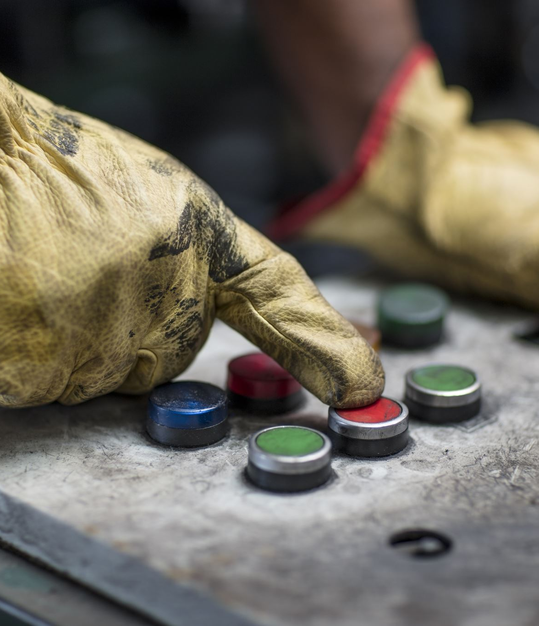
Incentivising validators to not lie
We used the same proof-of-stake model that apply to the user to also the validators themselves. We do this to make sure validators judgements are correct and to remove any reason for validators to fix a match.
We do so by making a validator make a deposit, as a stake, which will be returned to the validator if no bad acting is found.
When a validator judges a conflict fairly they are also rewarded, this comes from the liars deposit.

Slide 19
How the validation process works
Optional choice of participating in validation process, if they do then:
A deposit must be made that the participants themselves determine
Participants are rewarded if tell the truth
Participants partially lose their deposit if they lie
To ensure that validators do not lie they are required to make a deposit greater than the price of the tickets + deposits:
validator deposit > ticket price + deposit
This will mean that if validators lie, there deposit will be taken away and they will not be rewarded. As the deposit made by them is greater than the reward they could receive, it is highly unlikely that they will take the risk of lying.

Slide 20
Validating validators
Validators will validate both tournament matches when there is a disagreement between the users, and other validators work. Validators will not know which match they are working on, and where they are in the validating line.
Validators 1, 2, and 3 do not know they are in this order. Each validator is given the same tournament match which they each check over. If the previous validator was lying then the next validator in line receives part of the deposit they put in, but to confirm they are not lying themselves 5 other validators behind them must ensure they are saying the truth. If that validator is saying the truth, each validator after him who confirms and verifies his claim gains a percentage of the deposit left after the previous validator has already taken their part. This means that the coins received from validating a valid transaction decreases over number of validations.
Validator 1
Validator 2
Validator 3
Validate
Validate
50
100
200
Validators are always rewarded, as if there is dispute as to who won, then validators will receive the part of the liar's deposit, and if they validate a validator lying, then they will receive an even larger reward – as this is composed of the validator’s deposit and the liar's deposit . This incentivizes them to say the truth, as lying has a high risk and very little reward.

Slide 21

UI design

Slide 22
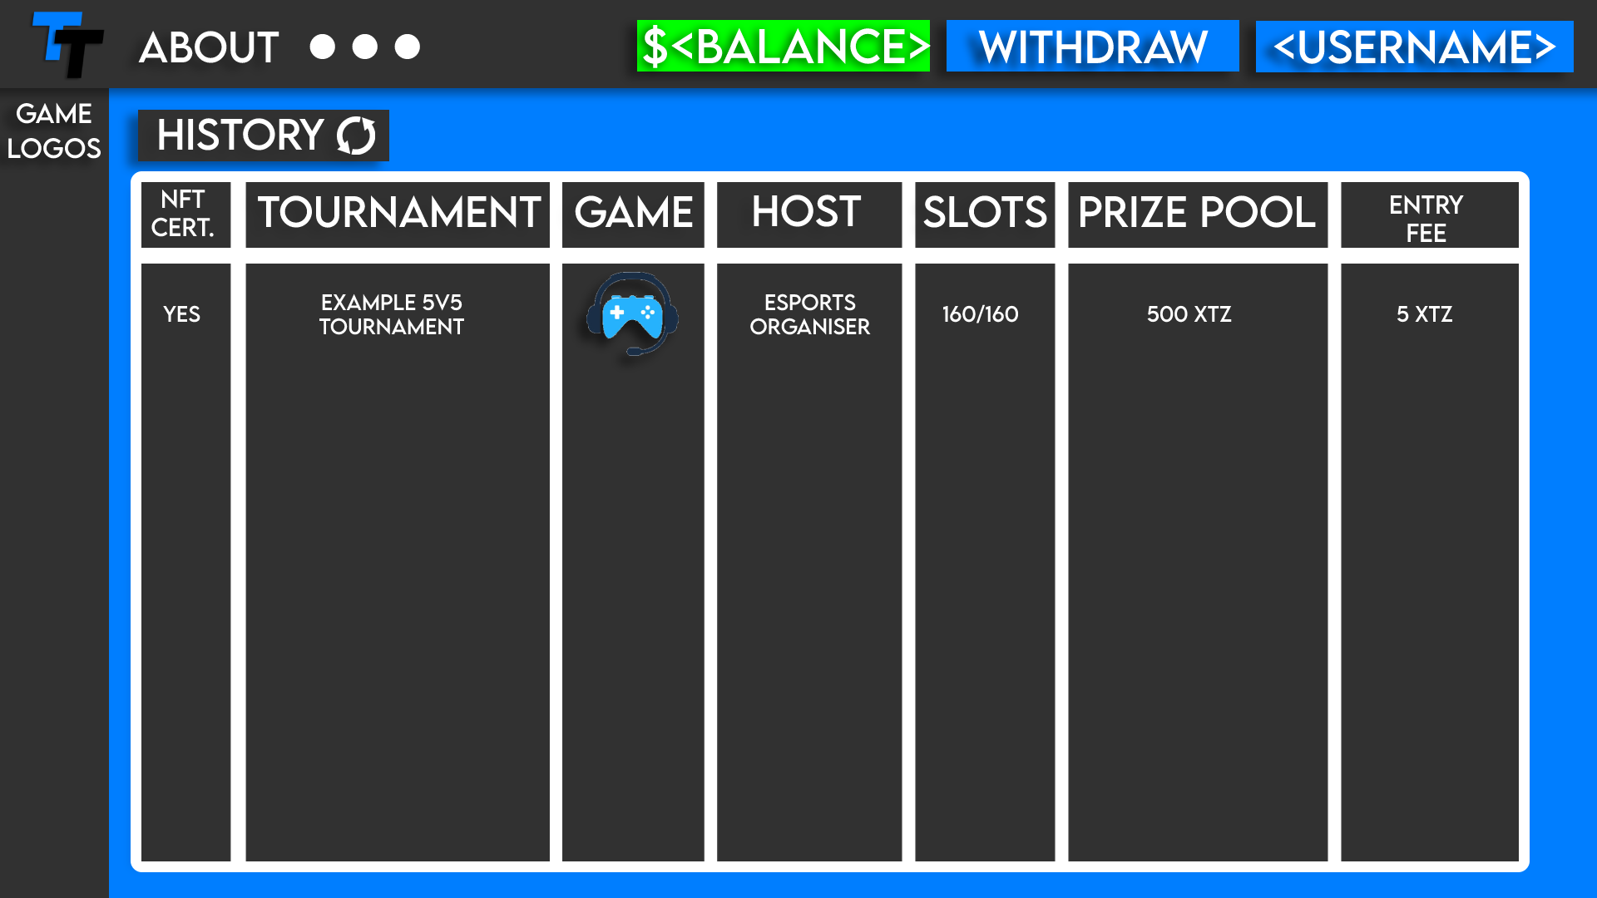
Home Page (Logged In)

Slide 23
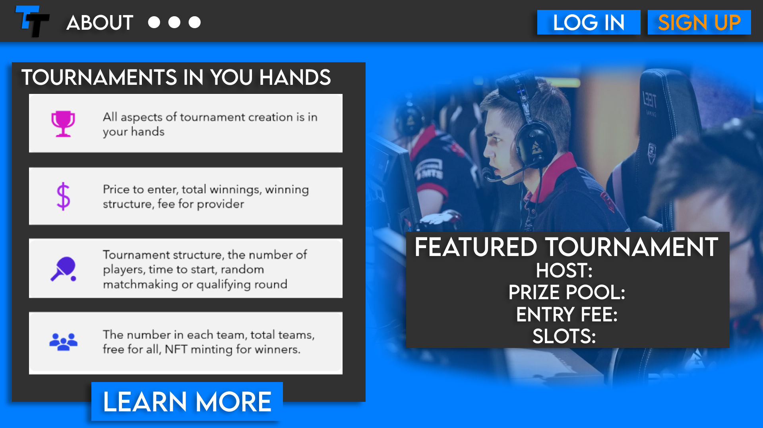
Home Page (Logged Out)

Slide 24
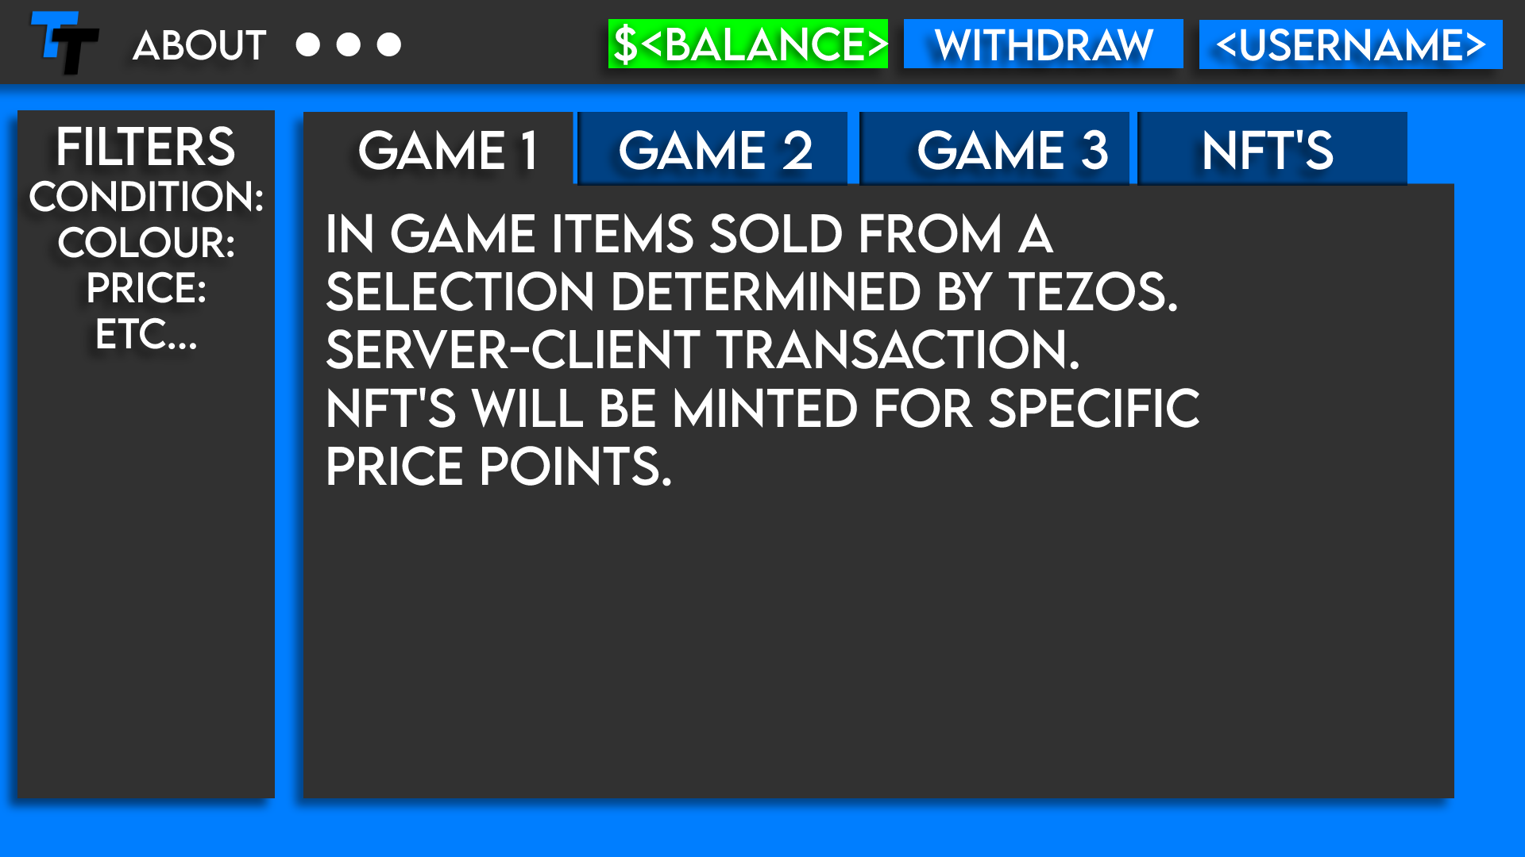
Store Page

